Slide 1
Leveraging Social Work Research Expertise to Influence Public Policy
SSWR Annual Conference
January 17, 2020

Slide 2
Agenda
Introduction of presenters
Summary of general expectations/objectives of the session
Explication of roundtable format and questions to be addressed
Participant presentations
Audience questions and comments
Discussion and attempt to capture consensus

Slide 3
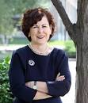
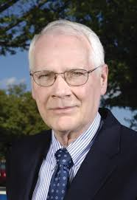
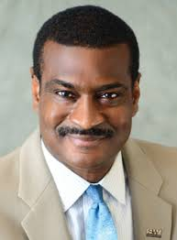
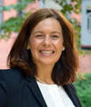
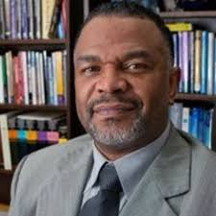
Presenters
Ron Manderscheid, Exec.
Dir, Nat. Assoc. of Co.
Behav. Health & Devel.
Disability Directors
Sarah Gehlert
President,
AASWSW
Angelo McClain
CEO, NASW
Sarah Christa Butts,
Dir. Of Public Policy,
NASW
Martell Teasley
President, NADD
Notes:
Do we need this?

Slide 4
Questions for Presenters
What is the current state of moving research to policy change in social work?
How might we better translate our research discoveries into change?
How does your organization contribute to translation?
What are your ideas for working together as professional organizations to advance the profession’s ability to translate research into policy change?
5. What new activities will your organization undertake to fulfill
the intent of this panel?

Slide 6
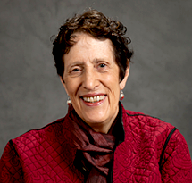
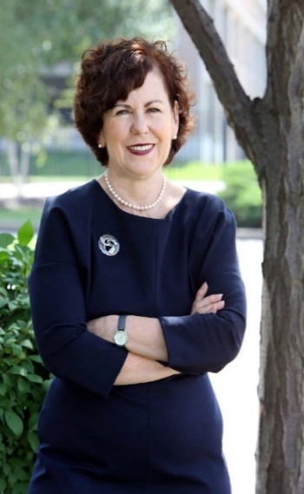
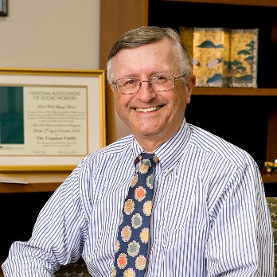
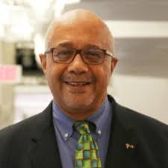
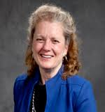
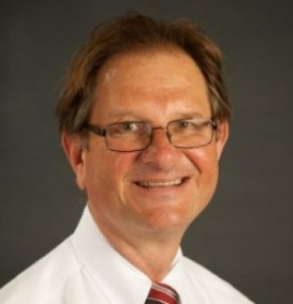
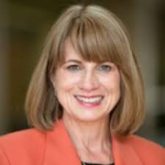
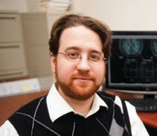
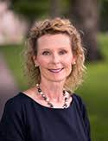
Academy Board Members
Nancy Hooyman
Sarah Gehlert
John Tropman
Jas. Herbert Williams
Ron Manderscheid
Paula Nurius
Mary McKay
Larry Palinkas
Jorge Delva
Shaun Each
Audrey Shillington
Cynthia Franklin
Notes:
Board Members Richard Barth, Larry Davis, Kathleen Ell, Rowena Fong, Sarah Gehlert, John Brekke, Jeff Jenson, Jeanne Marsh, Michael Sherraden, and Gail Steketee.

Slide 7
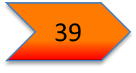
Academy incorporated in Ohio
Staff support from Mandel School;
Founding Sponsorship contributions from schools
501c3 status is approved by IRS
; first board election
Board of Directors began to meet monthly;
Induction Ceremony set as annual event
Inaugural Class of fellows; Board of Directors established; bylaws drafted
Fiscal management contracted – STAT; nearly 100k raised to support communications contract for GCSW
First Grand Challenges Executive Committee Meeting; website launched
2nd president inducted; move to University
of South Carolina
First staff person hired; operations move from Case to Maryland
Grand Challenges announced; GCSW webpages begun
1st strategic planning
session; committee
structure
2009
2010
2011
2013
2014
2015
2016
2017
2018
21
Fellows
29
39
56
73
85
98
115
128
149
113 monthly Board of Director meeting calls!
Notes:
Timeline of Accomplishments
2009
Academy is Announced
Incorporated in Ohio
Staff support from Case Western Reserve University, Mandel School
Founding Sponsorship contributions from schools
2010
Inaugural Class of fellows
Board of Directors established
Bylaws are drafted
2011
Board of Directors start to meet monthly
Induction Ceremony is set as an annual event
2012
Grand Challenges Planning Begins
GC Executive Committee established
2013
Staff Person Hired- Sarah Butts
Operations move from Case to Maryland
First Grand Challenges Executive Committee Meeting
New website is launched
2014
Fiscal management contracted – STAT
Nearly 100k raised to support communications contract for GCS
2015
21 Academy working papers completed
6 years of audits are completed
501c3 status is approved by IRS
First Board member election
2016
Grand Challenges announced at SSWR
New GC webpages launched
New Board members confirmed

Slide 8
Standing Process Committees Finance Committee: James Herbert Williams, Treasurer and Chair
Fund Raising Committee: Jorge Delva and Larry Palinkas, Co-Chairs
Nominations and Elections Committee: Cynthia Franklin, Chair

Slide 9
Standing Program Committees Performance Committee: Encourage and recognize outstanding research, scholarship, & practice that contribute to a sustainable, equitable, & just future
Innovation Research Committee: Promote analysis and research on policies, programs, and practice innovations for their impact on society
Awards Committee: Celebrate excellence in social work and social welfare research, education, & practice
Policy Information Committee: Inform social policy by serving as a frontline source of information for the social work profession as well as Congress & other government agencies & nongovernmental entities charged with advancing the public good

Slide 10
Policy Information Committee
Activities:
Policy briefs (e.g., working papers, position papers) sponsored by the Academy in conjunction with other national academies (e.g., Education; Nursing; Science, Engineering & Medicine) that leverage expertise from the SW Grand Challenges
Government engagement such as responses to Congressional requests & initiating work with Congressional entities in the form of providing congressional briefings, assembling expert panels, & developing policy briefs
Presence at NIH, etc. Representative to the NIMH National Council hearings
Chair: Ron Manderschied

Slide 11
Collaborations with Other Organizations
American Academy of Nursing
https://www.nurses.com/doc/american-academy-nursing-releases-policy-brief-vital-role-of-school-nurses-to-nation-youth-0001
Amicus Brief
http://www.childrensrights.org/wp-content/uploads/2018/03/Brief-by-Amici-Curiae-ECF-Stamped.pdf
National Academy of Education
https://curry.virginia.edu/sites/default/files/images/YVP/Call%20for%20Action%20FINAL%20for%20DISSEMINATION%204-6-18%20Corrections.pdf

Slide 12
2019 AASWSW Policy Initiative
“The Impact of Weapons and Violence on Schools and Surrounding Communities”
June 12, Rayburn Senate Office Building, Washington DC
Sponsored by Congresswoman Barbara Lee (CA-13)
Presenters:
Sean Joe, WUSTL
Marleen Wong, USC
Dorothy Espelage, (Dept. Psychology, Univ of Florida)
Ron Avi Astor, UCLA
Pia Escudero (LA Unified School District, Div Health & Human Services)
Lauren Hogg (Parkland survivor)

Slide 13
2019 AASWSW Policy Initiative
Central Planning:
Clark-Fox Policy Institute, Washington University in St. Louis
CRISP
AASWSW
Ron Avi Astor, UCLA
NASW
Co Sponsorship:
National Association of Education
American Psychological Association (Division 15),
Los Angeles United School District
American Educational Research Association
SSSWR

Slide 14
Discussion and Attempt
to Capture Consensus

Slide 15
Sustaining Sponsors
Boston College
Boston University
Case Western Reserve University
Michigan State University
Ohio State University
Rutgers University
University of California Los Angeles
University of Connecticut
University of Denver
University of Maryland
University Michigan
University of Southern California
University of Tennessee
University of Texas at Austin
University Washington
Washington University in St. Louis

