Slide 1
Integrating Adolescent Brain Development into Child Welfare Practice with Older Youth Day Two (Modules 8 to 13)

Slide 2
Module Eight: Key Learnings

Slide 3
Key Learnings

Slide 4
Module Nine: Promoting Brain Gains

Slide 5
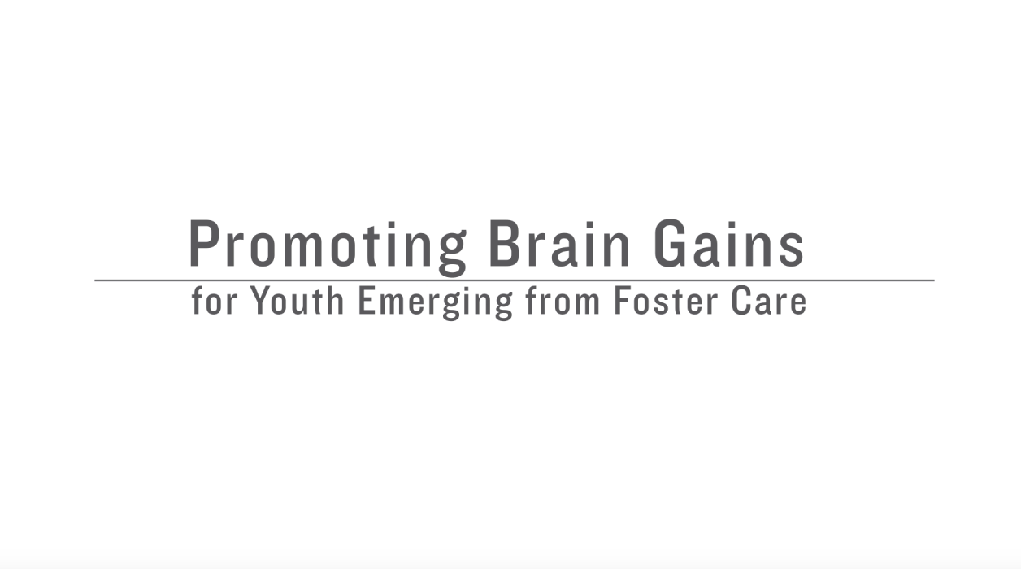
Video
https://www.youtube.com/watch?v=bRXQaa-DMXghttps://youtu.be/bRXQaa-DMXg

Slide 6
Discussion Questions:
What is one thing that struck you about this video that pertains to your work with youth?
What are some ways you are currently promoting brain gains?

Slide 7
Activity: Bio of a Young Person

Slide 8
Brain Friendly Interventions
Opportunities to Choose: young people need frequent occasions to make significant choices to help develop the decision-making regions in the ‘’reasoning brain’’ (the prefrontal cortex)
Self-Awareness Activities: young people experience an acute sense of self-consciousness and are actively building an inner core identity during adolescence (another prefrontal cortex function)
Peer Learning Connections: young people prefer the company of their friends to being with adults (e.g. parents, teachers, or other authority figures); areas of the brain associated with emotional distress light up in brain scan studies if teens are socially rejected

Slide 9
Brain Friendly Interventions (cont.)
Affective Learning: the ‘’emotional brain’’ (limbic system) is going full throttle by early adolescence while the ‘’reasoning brain’’ (prefrontal cortex) is still being installed; the young person learns more effectively when there is emotional content to accompany a lesson or other learning topic.
Metacognitive Learning: this refers to ‘’thinking about thinking’’ or the capacity to use the mind to regulate its own processes through planning, goal-setting, reflecting on one’s past experience, and other self-regulating mental activities; this area is developing throughout adolescence as a prefrontal cortex function

Slide 10
Brain Friendly Interventions (cont.)
Expressive Arts Activities: the highly developed ‘’emotional brain’’ is primed to creatively express itself, while the still-developing prefrontal cortex function of ‘’inhibition’’ is not censoring these creative ideas as much as it will in adulthood, so this is a critical period for creative and artistic activities
Real Life Experiences: young people can reason like adults by age sixteen but only if there are no emotional or peer influences (a condition called ‘’cold cognition’’); real life learning provides an appropriate setting within which they can be challenged to make good decisions in the midst of social or emotional pressures (a condition termed ‘’hot cognition’’):

Slide 11
Reflections
What specific brain friendly interventions can I incorporate into my practice with young people?

Slide 12
Module Ten: Promoting Brain Gains Through Positive Youth Development

Slide 13
What does positive youth development mean?

Slide 14
Positive Youth Development
“Positive Youth Development or PYD is an intentional, prosocial approach that engages youth within their communities, schools, organizations, peer groups, and families in a manner that is productive and constructive; recognizes, utilizes, and enhances young people’s strengths; and promotes positive outcomes for young people by providing opportunities, fostering positive relationships, and furnishing the support needed to build on their leadership strengths.”
Interagency Working Group on Youth Programs
Source: https://youth.gov/youth-topics/positive-youth-development

Slide 15
Partner Activity
Create a headline out of the key words that sum up your positive youth development definition.

Slide 16
Positive Youth Development = Positive Experiences + Positive Relationships + Positive Environments

Slide 17
Positive youth development approaches involve three types of inputs
SERVICES
SUPPORTS
OPPORTUNITY

Slide 18
Quality Services
Could include education, preparation for adulthood activities, after school activities, trauma-informed services exhibit:
Relevant instruction and information;
Challenging opportunities to express oneself, to take on new roles, and be part of a group;
Supportive adults and peers who provide respect, high standards and expectations, guidance and affirmation to young people.

Slide 19
Opportunities
Include chances for young people to learn how to interact with the world around them; test out ideas and behaviors and experiment with different roles
Roles must be perceived as challenging and legitimate to young people
Tasks that are taken on and done by the young person not things that are done to them
Done BY young people and not FOR young people.

Slide 20
Discussion Questions
What types of opportunities do you provide to the youth with whom you work?
How do opportunities promote brain gains?

Slide 21
Supports
Defined by interpersonal relationships that allow young person to take full advantage of existing services and opportunities.
Take on various forms but must be affirming and respectful, ongoing, and offered by a variety of people
Done WITH young people rather than TO them.
Another way of building networks of support can often be referred to as building social capital.
How do supports promote brain gains?

Slide 22
Enhancing Your Role as a Functional Helper
Resist doing things for people that they can do for themselves;
Provide clear and constructive feedback that notes positive behaviors as well as areas for improvement;
Engage young people as partners in formulating plans for improvement of their lives or behaviors

Slide 23
Optional Activity: The Social Web

Slide 24
Social Capital

Slide 25
Discussion Question
What do we mean when we say, we need to build social capital?

Slide 26
Social Capital
Comprised of social networks and social relationships, a bonding between similar people and a bridging between diverse people
Described as the value that is created by investing in relationships with others through processes of trust and reciprocity

Slide 27
Recognized Dimensions of Social Capital
The quantity of an individual’s social relationships,
The quality of those relationships, and
The value of the resources that partners in social relationships can potentially make available to one another.
Social capital is fundamentally about how people interact with each other.
Source: Social Capital: Building Quality Networks for Young People in Foster Care

Slide 28
Activity 1, 2, 4, All: Social Capital

Slide 29
Positive Youth Development & Trauma
Services, opportunities, and supports are essential in counteracting effects of trauma to promote healthy brain and social development in adolescence
Critical need for effective trauma-informed and trauma-specific practices in addressing identity and grief-related issues that older youth and young adults in foster care are likely to experience
Concepts of resiliency and neuroplasticity provide a foundation
Neurological imperative
“Use it and improve it”

Slide 30
Reflections
How can incorporate positive youth development philosophy into my practice with young people?

Slide 31
Module Eleven: Examining Our Attitudes When Working With Young People

Slide 32
Spectrum of Attitudes
Object
Recipient
Resource/Partner

Slide 33
Being Viewed as Objects
When young people are viewed as objects, the worker has little value for young person and has ultimate control over the case
Less extreme view is that worker knows best, and families are the objects of our good intentions
Little room for input or for inclusion of their ideas
Worker-driven view and values compliance and policy
For young people it creates the sense that things are being done “to” them

Slide 34
Being Viewed as Recipients
Puts emphasis on young people benefiting from services offered
Workers include young people in participation in planning process, but with focal point on how young person will benefit from the service
No focus on what the young person has to offer, and worker is in control of the conditions for participation
Some opportunity for building a sense of ownership in the decision-making process
Creates feeling that things are being done “for” the young person by the worker who knows best

Slide 35
Being Viewed as Resources/Partners
Based on a respect for the contributions young people can make
Decision-making and leadership roles are shared between youth, adult, and workers; created when workers, along with young people, learn the attitudes and skills needed for shared leadership and decision-making
Creates the feeling of doing “with” for both worker and young person

Slide 36
Attitudes Towards Youth in Child Welfare System
What are the prevalent attitudes and approaches youth encounter as they negotiate the various services, supports, and opportunities?
Which of the three approaches contributes to building a positive relationship?
When is the “Object” approach most appropriate? Recipient? Resource?

Slide 37
Activity: Role Play
Youth role:
How did the conversation change as the worker used different approaches?
What feelings did you have when you were approached as an “object”? “recipient”? “resource”/ “partner”?
How did it change your level of motivation or desire to participate in planning or in services?

Slide 38
Activity: Role Play (cont.)
Worker role:
In what ways did your intentions change as you altered your approach?
What skills did you employ when you made the shift to partnering with youth?
What kinds of questions did you ask when engaging from the resource/partner attitude?
Which approach did you find easiest? Most challenging?
Did you find yourself reverting back to relating to the youth as an object or a recipient when you were trying to relate to them as a resource/partner?

Slide 39
Reflections
How can I move towards working with young people as resources and partners?

Slide 40
Module Twelve: Promoting Youth Adult Partnership

Slide 41
Youth-Adult Partnership
Treats young people as equal partners
Cultivates trust
Enables young people to build self-esteem
Supports the development of problem-solving and leadership skills.

Slide 42
Youth-Adult Partnership
Requires sharing information
Having honest conversations
Respecting varied experiences and opinions
Setting clear expectations regarding roles and decision making.

Slide 43
What are some skills you use working in partnership with young people?

Slide 44
Power Dynamics
What do you have authority over in your role?
(Where do you hold power?)
What might it look like to share power with young people?
What makes you nervous about that? What excites you about that? What would it take to make those shifts?

Slide 45
What conditions need to exist for youth-adult partnerships to flourish?

Slide 46
Attitudes & Stereotypes Impacting Youth-Adult Partnerships
What are some stereotypes young people hold about adults in the child welfare system? What might be underneath those thoughts/biases?
What are some stereotypes adults hold about young people in the child welfare system? What might be underneath those thoughts/biases?

Slide 47
Language Matters
Use intentional language to signify shared power:
Focus on “we” and ”us” language rather than “I” or “You”
Refer to youth with strengths-based, developmentally-appropriate terms to reduce hierarchal, authoritative language
Do not jump directly to offering solutions
Be clear with boundaries and non-negotiables while also seeing opportunities for autonomy and agency in challenging situations

Slide 48
Activity: Language Matters When Building Partnership

Slide 49
Youth/Adult Partnerships: Self-Assessment Tool

Slide 50
Activity 6: Developing an Action Plan

Slide 51
Action Plan
As a result of this training I have acquired the following new knowledge, skills and attitudes:
As a result of this training I am going to discuss the following learning strengths and needs with my supervisor:
As a result of this training I am going to do the following or make the following specific changes using the new knowledge, skills and attitudes in the next month in my practice with young people:

Slide 52
Thank You!

